Slide 1
Distributed COORDINATION STRATEGY FOR TARGET ENCLOSURE BY Turtlebots
Rohit Sonker
Summer Project (Under Supervision of Prof. laxmidhar Behera)
Intelligent Systems & Control Lab, IIT Kanpur
July 2016

Slide 2
Introduction
Here a methodology for group coordination and cooperative control of n agents to achieve
a target-enclosing operation is presented.
In the developed coordination strategy, multiple agents are controlled in a distributed manner to converge to an assigned formation while tracking the target object moving in space.
Features
Memory-less control scheme.
No communications between agents is necessary.
Each agent decides its behaviour based on local information of only one other agent and the target object .

Slide 3
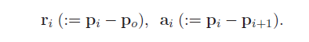
Problem Statement
Consider n agents dispersed in space. Each agent is modelled as a point object and all agents are ordered from 1to n i.e. P1, P2 ….. Pn.
Position vectors of target and agents are denoted by p_{0,} p_{1,} p_{2,…,} p_{n.}
It is assumed that each agent Pi can measure following vectors –
Further information regarding the velocity of the target is required.
There are two frame of references
Inertial Frame
Target fixed Frame centred at the target with X,Y,Z axes parallel to the inertial frame of reference.

Slide 4
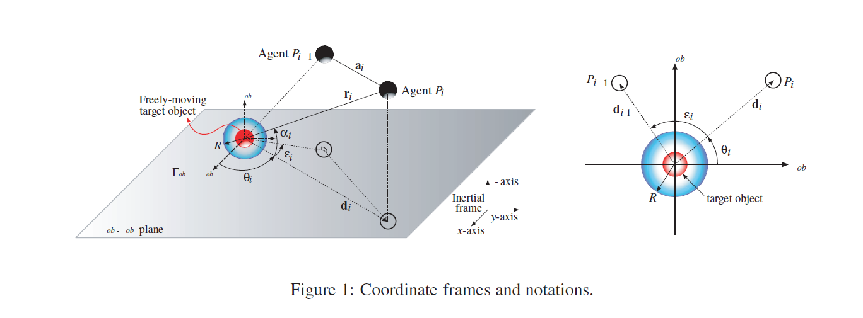
COORDINATE FRAMES AND NOTATIONS
Kim, T., T. Sugie, and T. Korogi. "Distributed coordination strategy for target-enclosing operations by particle swarms." WSEAS Trans. Syst. Control 10 (2015): 289-296.

Slide 5
FORMATION
The Control objectives are as follows :
N agents enclose the target , they are spaced out around the target object of assigned angles and maintain those angles.
Each agent approaches the target object , maintaining a distance R.

Slide 6
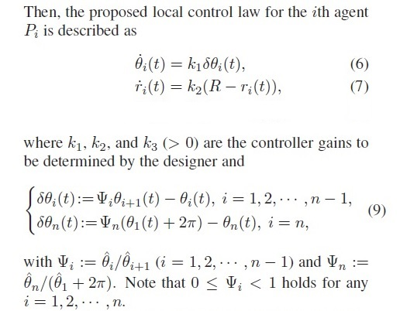
Control laws
Kim, T., T. Sugie, and T. Korogi. "Distributed coordination strategy for target-enclosing operations by particle swarms." WSEAS Trans. Syst. Control 10 (2015): 289-296.

Slide 7
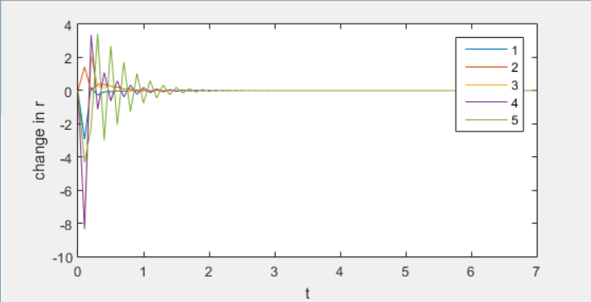
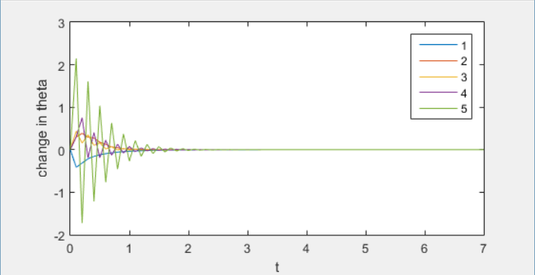
Simulation in matlab

Slide 8
Simulation in ROS
Simulations were carried out in ROS using the turtlebot model robot in the gazebo simulator.
Actuation limits are set to 1 unit/s for linear speed and 1 rad/s for angular speed.

Slide 9
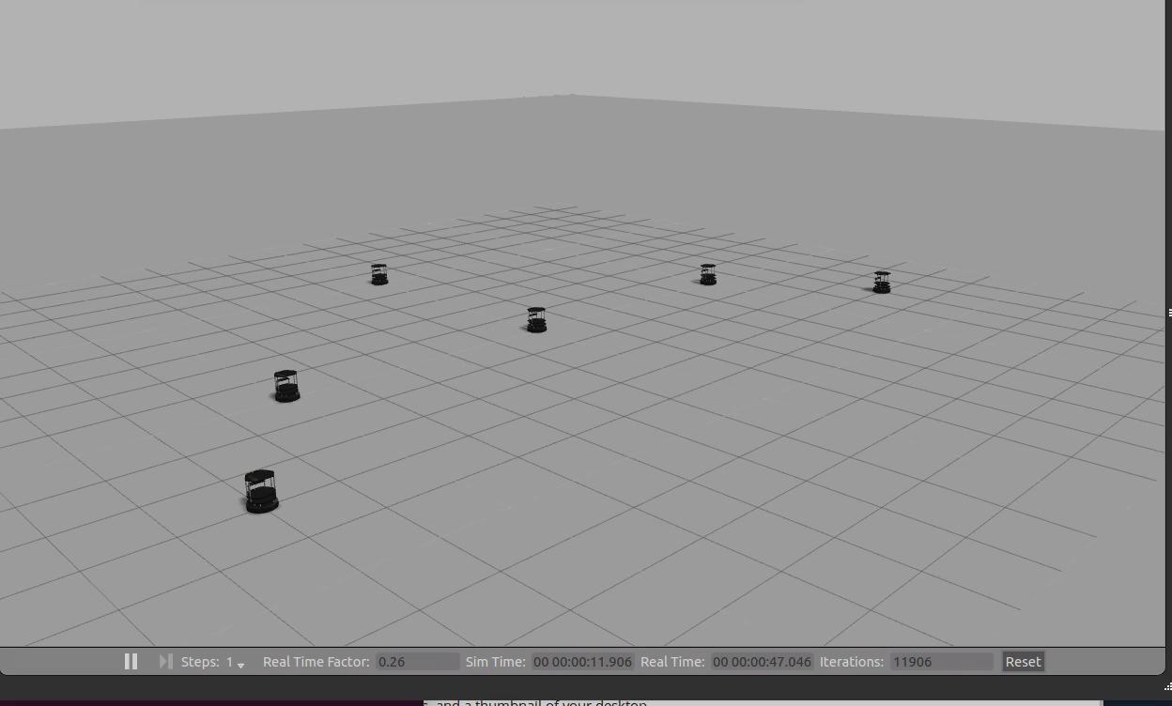

Slide 10
Future Work
To use raw sensor observations to estimate position and velocity of turtlebots
Expand to aerial drones with more degrees of freedom of motion
Expand to other scenarios of formation control

